Slide 1
Cornerstone City Church Peninsula Plus Community Hoo Are Ya
3rd November 2024

Slide 2


Slide 3
Glorious Day
CCLI Song # 7081388
Jason Ingram | Jonathan Smith | Kristian Stanfill | Sean Curran
© 2017 KPS 1.0 (Admin. by Capitol CMG Publishing)
sixsteps Music (Admin. by Capitol CMG Publishing)
sixsteps Songs (Admin. by Capitol CMG Publishing)
Sounds Of Jericho (Admin. by Capitol CMG Publishing)
Worship Together Music (Admin. by Capitol CMG Publishing)
worshiptogether.com songs (Admin. by Capitol CMG Publishing)
Fellow Ships Music (Admin. by Essential Music Publishing LLC)
Hickory Bill Doc (Admin. by Essential Music Publishing LLC)
So Essential Tunes (Admin. by Essential Music Publishing LLC)
For use solely with the SongSelect® Terms of Use. All rights reserved. www.ccli.com
CCLI Licence No. 33265

Slide 4
1/6
I was buried beneath my shame
Who could carry that kind of weight
It was my tomb 'til I met You

Slide 5
2/6
I was breathing but not alive
All my failures I tried to hide
It was my tomb 'til I met You

Slide 6
3/6
('Cause when) You called my name (and)
I ran out of that grave
Out of the darkness into Your glorious day
You called my name (and) I ran out of that grave
Out of the darkness into Your glorious day

Slide 7
4/6
Now Your mercy has saved my soul
Now Your freedom is all that I know
The old made new Jesus when I met You

Slide 8
5/6
I needed rescue my sin was heavy
But chains break at the weight of Your glory
I needed shelter I was an orphan
Now You call me a citizen of Heaven
When I was broken You were my healing
Now Your love is the air that I'm breathing
I have a future my eyes are open

Slide 9
6/6
('Cause when) You called my name (and)
I ran out of that grave
Out of the darkness into Your glorious day
You called my name (and)
I ran out of that grave
Out of the darkness into Your glorious day

Slide 10
Open The Eyes of My Heart
CCLI Song # 2298355
Paul Baloche
© 1997 Integrity's Hosanna! Music (Admin. by Integrity Music Ltd)
For use solely with the SongSelect® Terms of Use. All rights reserved. www.ccli.com
CCLI Licence No. 33265

Slide 11
1/3
Open the eyes of my heart Lord
Open the eyes of my heart
I want to see You
I want to see You

Slide 12
2/3
To see You high and lifted up
Shining in the light of Your glory
Pour out Your power and love
As we sing holy holy holy

Slide 13
3/3
Holy holy holy
Holy holy holy
Holy holy holy
I want to see You

Slide 15
Raise A Hallelujah
CCLI Song # 7119315
Jake Stevens | Jonathan David Helser | Melissa Helser | Molly Skaggs
© 2018 Bethel Music Publishing (Admin. by Song Solutions)
For use solely with the SongSelect® Terms of Use. All rights reserved. www.ccli.com
CCLI Licence No. 33265

Slide 16
1/7
I raise a hallelujah in the presence of my enemies I raise a hallelujah louder than the unbelief I raise a hallelujah my weapon is a melody I raise a hallelujah Heaven comes to fight for me

Slide 17
2/7
I’m gonna sing in the middle of the storm Louder and louder you’re gonna hear my praises roar Up from the ashes hope will arise Death is defeated the King is alive

Slide 18
3/7
I raise a hallelujah with everything inside of me I raise a hallelujah I will watch the darkness flee I raise a hallelujah in the middle of the mystery I raise a hallelujah fear you lost your hold on me

Slide 19
4/7
Sing a little louder (Sing a little louder) Sing a little louder (Sing a little louder)

Slide 20
5/7
Sing a little louder in the presence of my enemies Sing a little louder louder than the unbelief Sing a little louder my weapon is a melody Sing a little louder Heaven comes to fight for me

Slide 21
6/7
I’m gonna sing in the middle of the storm Louder and louder you’re gonna hear my praises roar Up from the ashes hope will arise Death is defeated the King is alive

Slide 22
7/7
I raise a hallelujah in the presence of my enemies I raise a hallelujah louder than the unbelief I raise a hallelujah my weapon is a melody I raise a hallelujah Heaven comes to fight for me

Slide 24
King of Kings
CCLI Song # 7127647
Brooke Ligertwood | Jason Ingram | Scott Ligertwood
© 2019 Fellow Ships Music (Admin. by Essential Music Publishing LLC)
So Essential Tunes (Admin. by Essential Music Publishing LLC)
Hillsong Music Publishing Australia (Admin. by Hillsong Music Publishing UK)
For use solely with the SongSelect® Terms of Use. All rights reserved. www.ccli.com
CCLI Licence No. 33265

Slide 25
1/9
In the darkness we were waiting
Without hope without light
Till from Heaven You came running
There was mercy in Your eyes

Slide 26
2/9
To fulfil the law and prophets
To a virgin came the Word
From a throne of endless glory
To a cradle in the dirt

Slide 27
3/9
Praise the Father
Praise the Son
Praise the Spirit three in one
God of Glory
Majesty
Praise forever to the King of kings

Slide 28
4/9
To reveal the kingdom coming
And to reconcile the lost
To redeem the whole creation
You did not despise the cros

Slide 29
5/9
For even in Your suffering
You saw to the other side
Knowing this was our salvation
Jesus for our sake You died

Slide 30
6/9
And the morning that You rose
All of heaven held its breath
Till that stone was moved for good
For the Lamb had conquered death

Slide 31
7/9
And the dead rose from their tombs
And the angels stood in awe
For the souls of all who'd come
To the Father are restored

Slide 32
8/9
And the Church of Christ was born
Then the Spirit lit the flame
Now this Gospel truth of old
Shall not kneel shall not faint

Slide 33
9/9
By His blood and in His Name
In His freedom I am free
For the love of Jesus Christ
Who has resurrected me

Slide 34
How Great Is Our God
CCLI Song # 4348399
Chris Tomlin | Ed Cash | Jesse Reeves
© 2004 sixsteps Music (Admin. by Integrity Music Ltd)
Vamos Publishing (Admin. by Integrity Music Ltd)
worshiptogether.com songs (Admin. by Integrity Music Ltd)
Wondrously Made Songs (Admin. by Song Solutions www.songsolutions.org)
For use solely with the SongSelect® Terms of Use. All rights reserved. www.ccli.com
CCLI Licence No. 33265

Slide 35
1/6
The splendour of the King
Clothed in majesty
Let all the earth rejoice
All the earth rejoice
He wraps Himself in light
And darkness tries to hide
And trembles at His voice
And trembles at His voice

Slide 36
2/6
How great is our God
Sing with me
How great is our God
And all will see how great
How great is our God

Slide 37
3/6
And age to age He stands
And time is in His hands
Beginning and the End
Beginning and the End
The Godhead three in one
Father Spirit Son
The Lion and the Lamb
The Lion and the Lamb

Slide 38
4/6
How great is our God
Sing with me
How great is our God
And all will see how great
How great is our God

Slide 39
5/6
Name above all names
Worthy of all praise
My heart will sing
How great is our God

Slide 40
6/6
How great is our God
Sing with me
How great is our God
And all will see how great
How great is our God

Slide 41


Slide 42


Slide 43
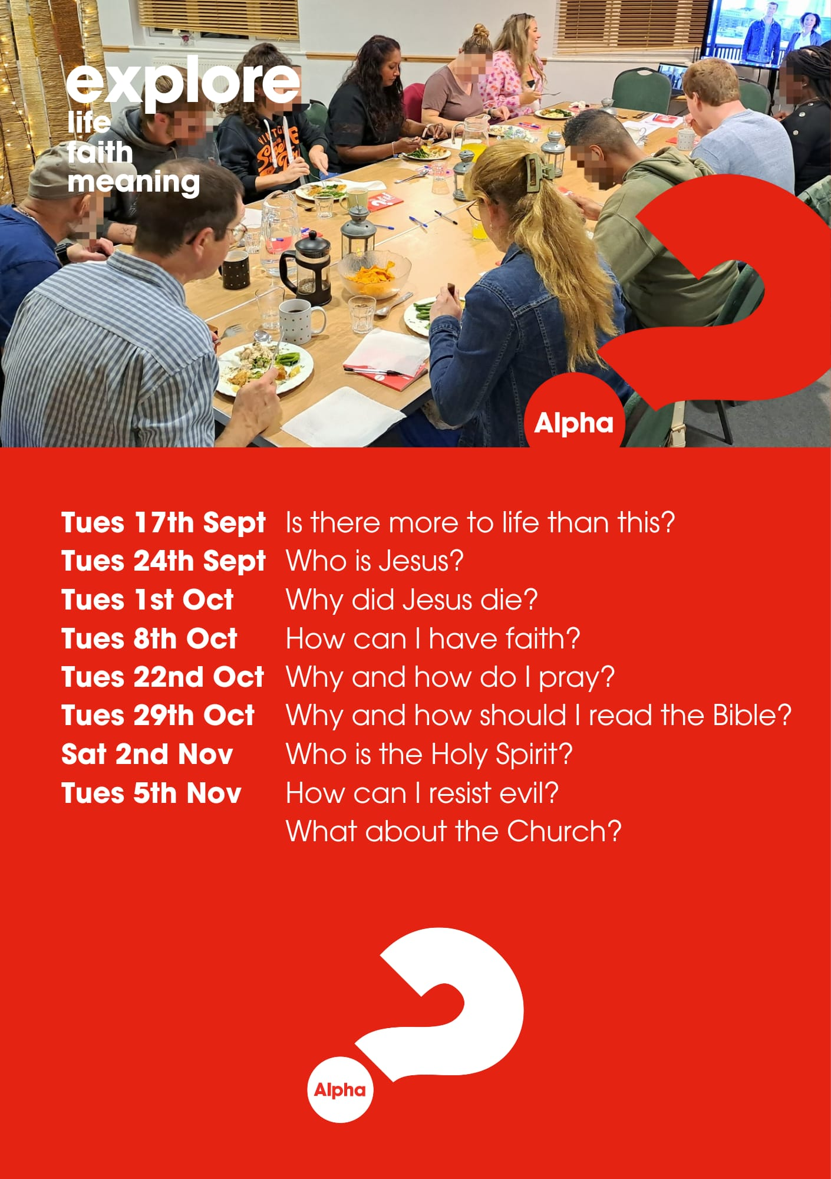

Slide 44
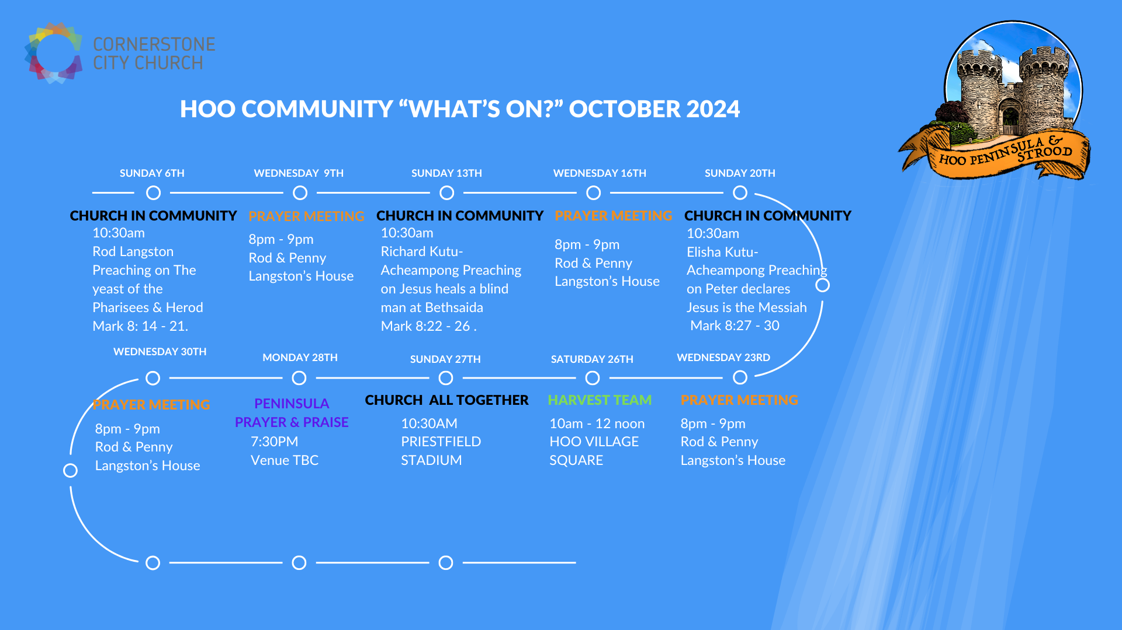

Slide 45


Slide 46
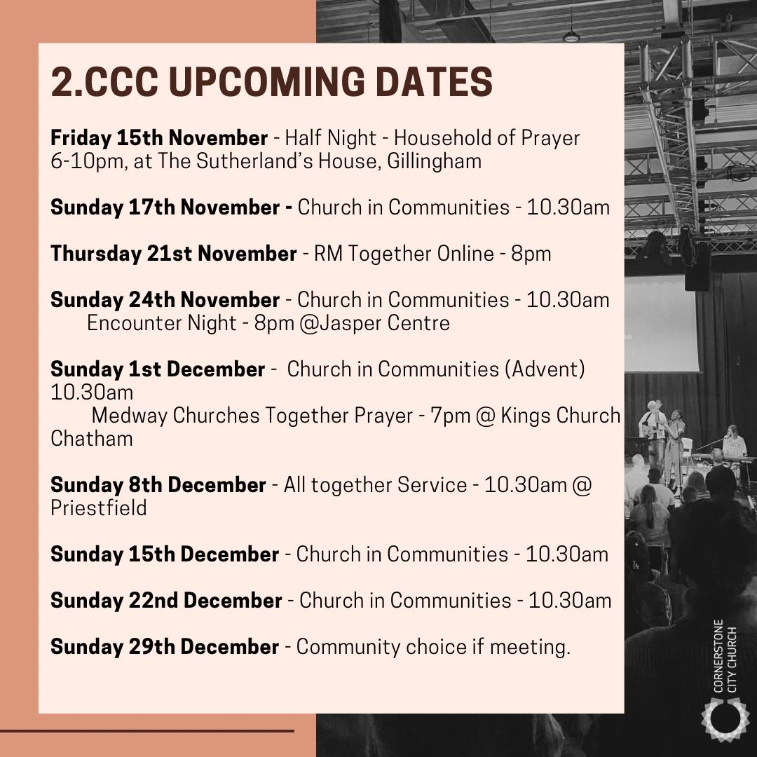

Slide 47


Slide 48
2 Corinthians 14 May the grace of the Lord Jesus Christ, and the love of God, and the fellowship of the Holy Spirit be with you all

